Slide 1
Potato Disease Prediction
Using Convolutional Neural Networks (CNN) for Early and Late Blight Detection
Presenter's Name:- Vaishnavi Tale

Slide 2
Problem Statment
Economic Losses:
Farmers growing potatoes face significant economic losses each year due to various diseases affecting potato plants.
Common Diseases: Two common diseases are Early Blight and Late Blight.
Early Blight: Caused by fungus.
Late Blight: Caused by specific microorganisms.
Importance of Early Detection:
Early detection and accurate identification are crucial for applying appropriate treatments, preventing waste, and avoiding economic loss.

Slide 3
Project Overview
Objective:
Develop a CNN model to identify potato plant diseases and create a user-friendly web application for easy interaction.
Key Components:
Data Collection and Pre-processing
CNN Model Building
Web Application Development

Slide 4
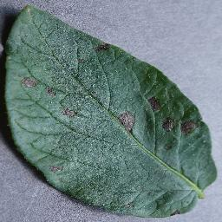
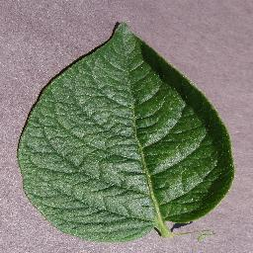
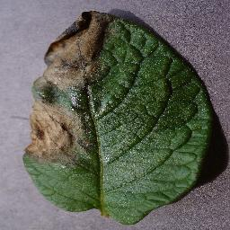
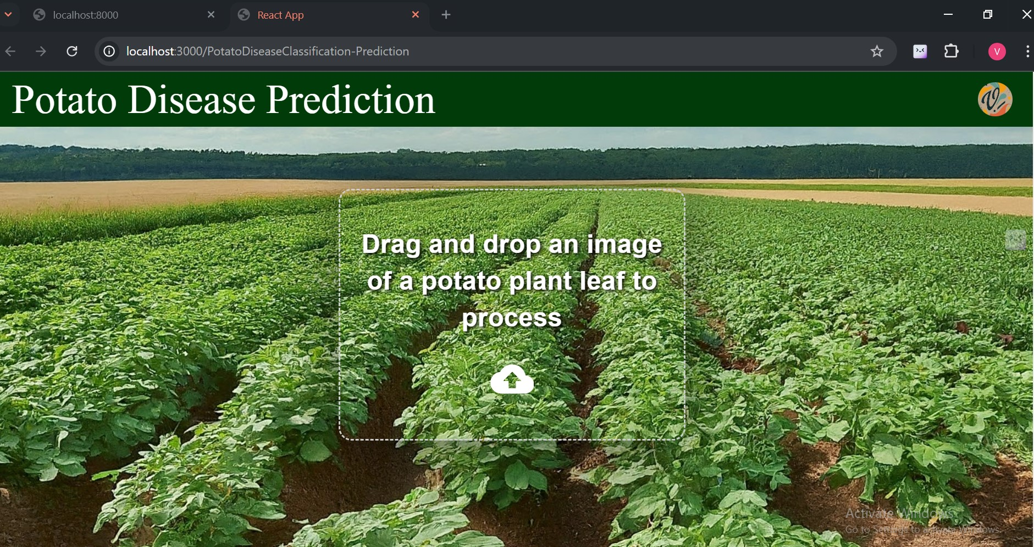

Architecture
Data Cleaning & Preprocessing
Model Building
tf dataset
CNN
Load model
Data Agumentation
Data Collection
http://localhost:8000
React.js

Slide 5
Data Collection
Gathering images of healthy and diseased potato plant leaves.
Download “PlantVillage” dataset from kaggle.com and extract potato plants images data from the dataset.
Dataset contains 1000 images of Early blight , 1000 images of Late blight and 152 images of Healthy plant leaves.

Slide 6
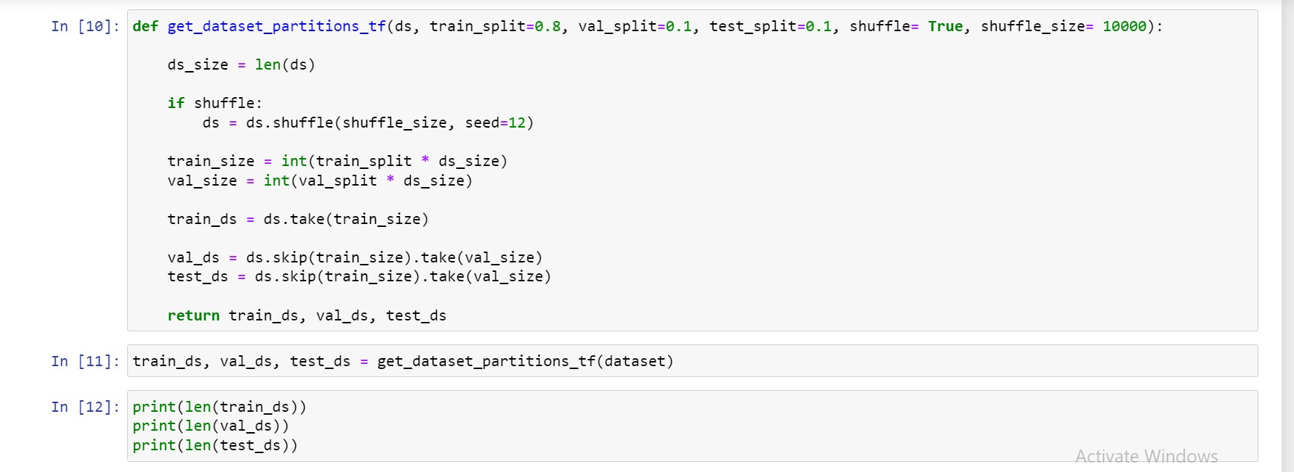
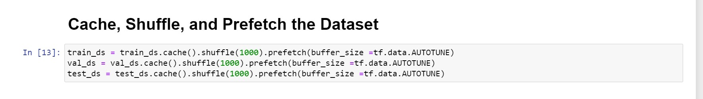
Data Cleaning and Preprocessing
Dataset should be bifurcated into 3 subsets, namely:
Training: Dataset to be used while training
Validation: Dataset to be tested against while training
Test: Dataset to be tested against after we trained a model
Cache , Shuffle and Prefetch the datasets :

Slide 7
Data Cleaning and Preprocessing
Data Preprocessing :
Before we feed our images to network, we should be resizing it to the desired size. Moreover, to improve model performance, we should normalize the image pixel value (keeping them in range 0 and 1 by dividing by 256). This should happen while training as well as inference. Hence we can add that as a layer in our Sequential Model.
This will be useful when we are done with the training and start using the model for predictions. At that time somone can supply an image that is not (256,256) and this layer will resize it
Data Agumentation
Data augmentation is a technique used in machine learning to increase the size and diversity of a dataset by artificially generating new data samples from existing ones.
we have less data, this boosts the accuracy of our model by augmenting the data.

Slide 8
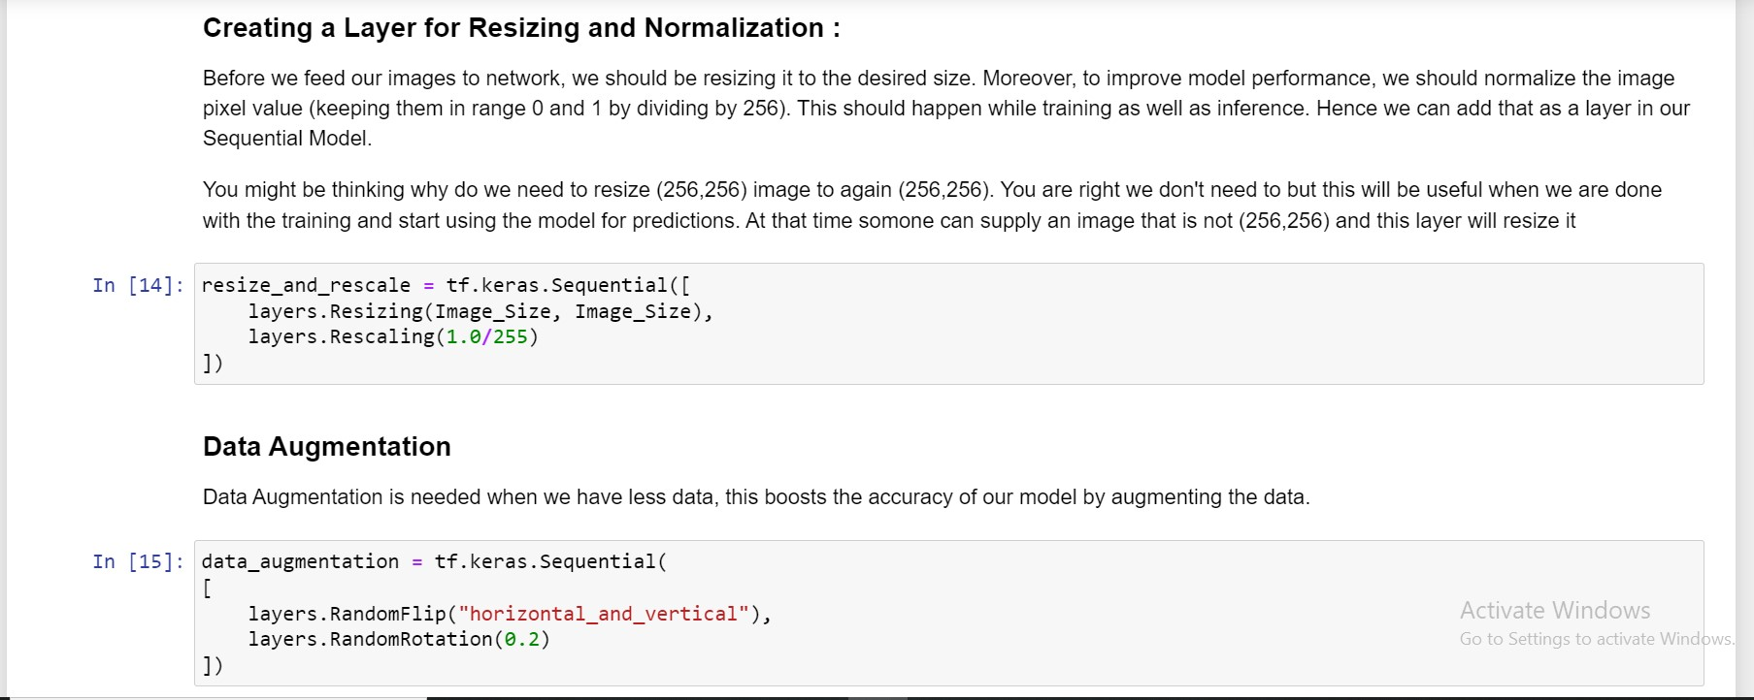

Slide 9
Model Building
Model Architecture:
Used convolutional neural network (CNN) here. CNN is popular for image classification tasks.
CNN coupled with a Softmax activation in the output layer
Utilizing TensorFlow for training the CNN model.
Image Classification:
Classifying images into "Early Blight," "Late Blight," or "Healthy."

Slide 10
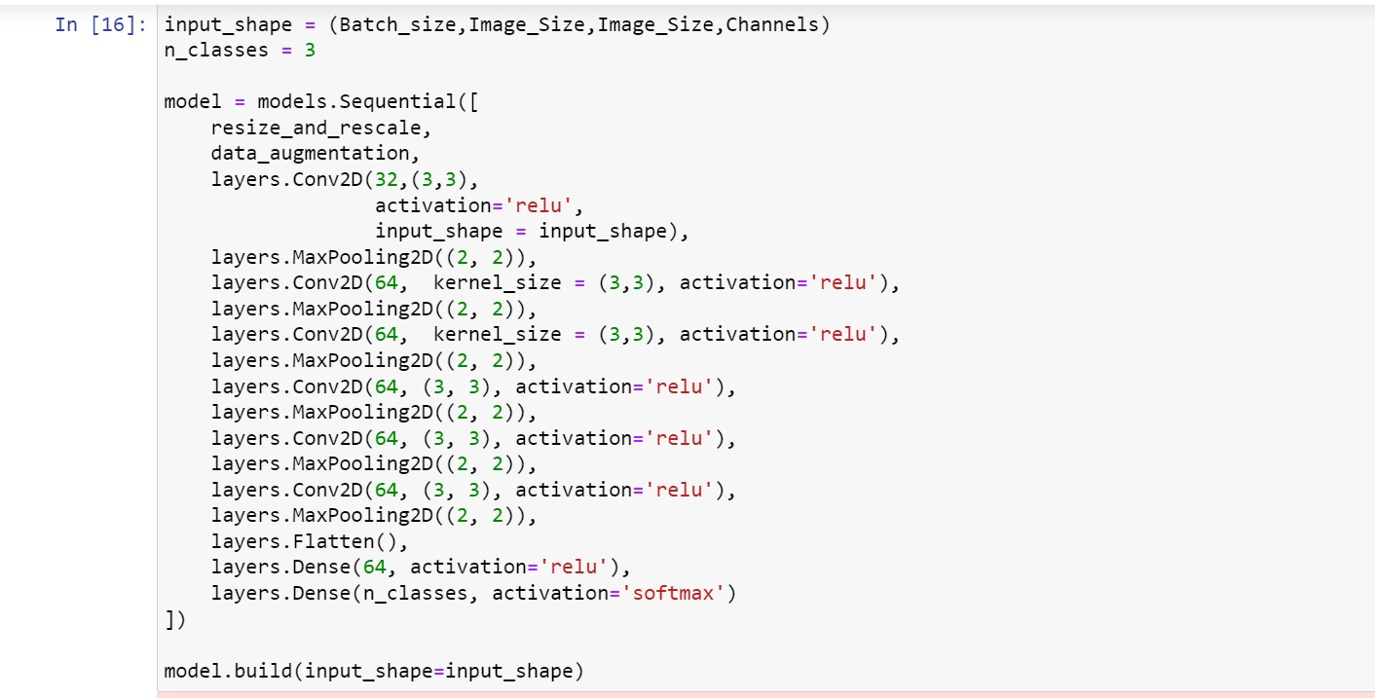
Model Building

Slide 11
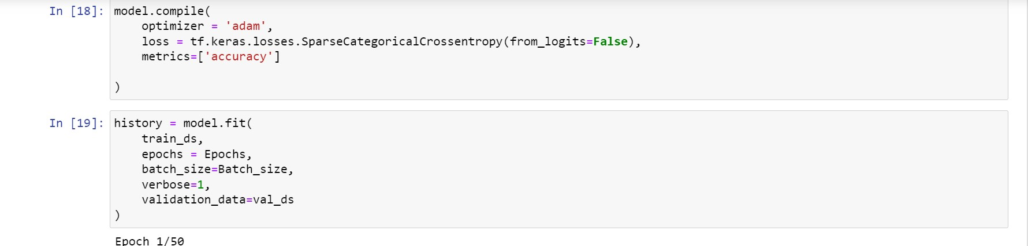
Model Training
Training Process:
Used adam Optimizer, SparseCategoricalCrossentropy for losses, Accuracy as a Performance Metric

Slide 12
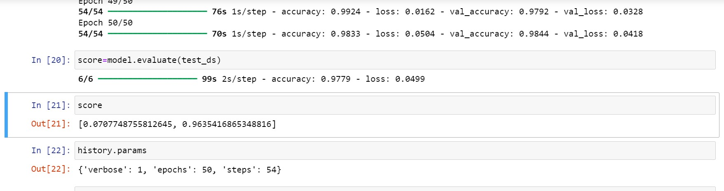
Model achieves approximately 98% accuracy.

Slide 13
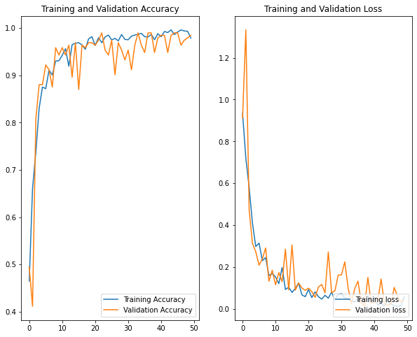
Graphs of Training and Validation Accuracy & Training and Validation Loss.

Slide 14
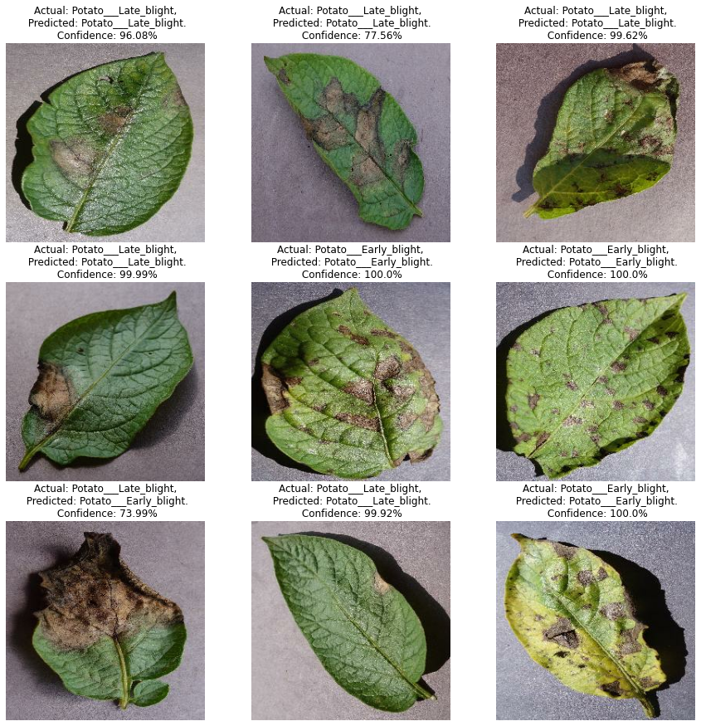

Slide 15
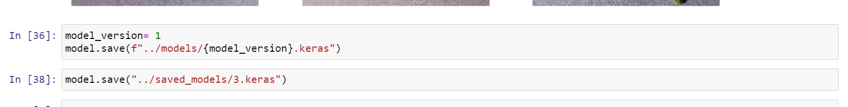
Load Model
loading trained as .keras file to create FastAPI

Slide 16
FastAPI for Image Classification
Introduction to FastAPI:
Modern web framework for building APIs with Python.
High performance and ease of use.
Create a FastAPI application for the model at http://localhost:8000

Slide 17
Web Application Development
Frontend Development:
Using React JS to develop a user-friendly interface.
With Features image upload and displaying predictions.
Backend Development:
Integrating FastAPI with the CNN model.
Handling image processing and prediction outputs.

Slide 18
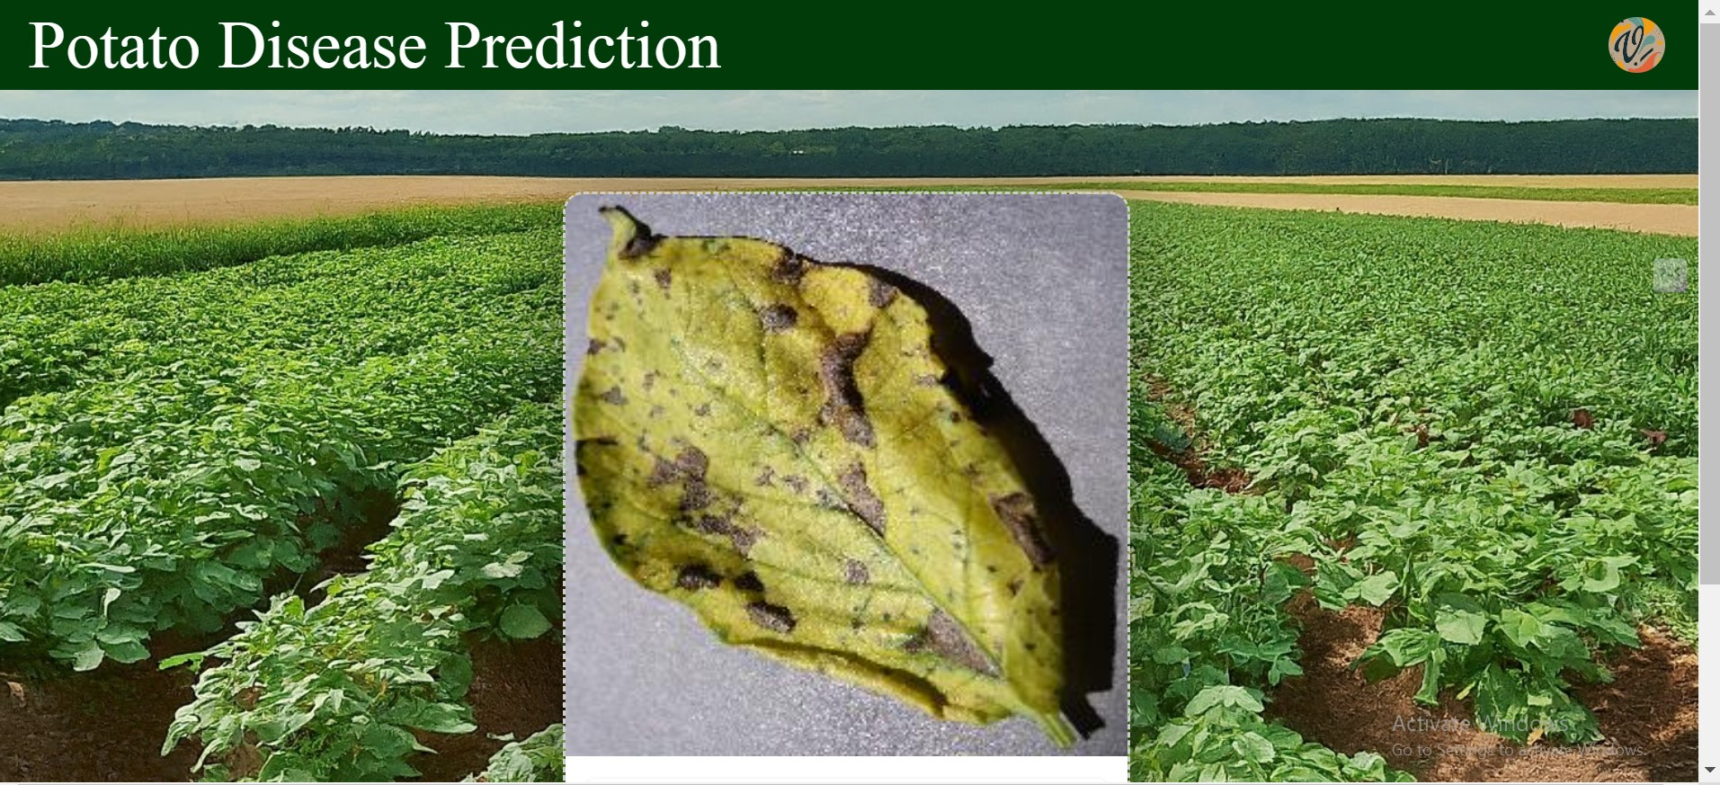
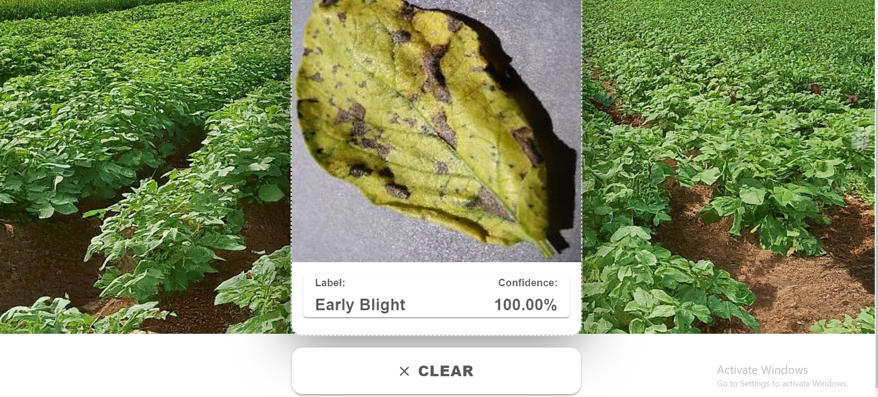
Demonstration

Slide 19
Conclusion and Future Work
Conclusion:
The model accurately identifying the disease of the potato plant.
Benefits to farmers and agricultural practices as Early detection and accurate identification are crucial for applying appropriate treatments.
Web Application makes it easy for user interaction.
Future Work:
Enhancements to the model and application.
Potential for integrating more plant diseases.
Expanding the mobile app functionality.

Slide 20
References
dataset link :- https://www.kaggle.com/datasets/abdallahalidev/plantvillage-dataset
https://www.kaggle.com/
https://www.tensorflow.org/
https://reactjs.org/
https://fastapi.tiangolo.com/
https://plantvillage.psu.edu/
https://youtu.be/dGtDTjYs3xc?si=yelzG-Vc9XO-oqwL
https://ijrpr.com/uploads/V3ISSUE5/IJRPR4071.pdf
https://www.researchgate.net/publication/362365774_Potato_diseases_detection_and_classification_using_deep_learning_methods

Slide 21
Thank You

